Slide 1
Medicinal chemistry of Antipsychotic agents
BY: Ayana J.

Slide 2
Psychoses
psychogenic mental disorders involving a loss of contact with reality
Include schizophrenia, the manic phase of bipolar (manic–depressive)
illness, acute idiopathic psychotic illness, and other conditions marked by severe agitation
The most common is schizophrenia, in which perception, thinking, communication, social functioning, and attention are altered

Slide 3
Schizophrenia
characterized mainly by a clear sensorium but a marked thinking disturbance
  positive symptoms: e.g., delusions, hallucinations
  negative symptoms: (e.g., flat affect, apathy);
  cognitive dysfunction may occur
extremely complex and multifactored etiology:
  fundamental lesion appears to be a defect in the brain’s informational gating mechanism
the gating system has difficulty discriminating between relevant and irrelevant stimuli

Slide 4
DA hypothesis
overactivity of dopaminergic neurons in the mesolimbic system, mesocortical circuits & nucleus accumbens
basis for much of the rationale for drug therapy
  (a) drugs that increase dopaminergic neurotransmission:
    levodopa (a DA precursor), amphetamines (a DA releaser), and apomorphine (a DA agonist), induce or exacerbate schizophrenia.
    ‘amphetamine/cocaine psychosis’
  (b) DA receptor density is increased in certain brain regions of untreated schizophrenics

Slide 5
  (c) many antipsychotic drugs strongly block postsynaptic D2 receptors
  in CNS
  (d) successful treatment of schizophrenic patients: change the amount of homovanillic acid (HVA), a DA metabolite, in the cerebrospinal fluid, plasma, and urine.
antipsychotic action:
  block DA receptors in the mesolimbic and mesofrontal systems(extrapyramidal side effects, hyperprolactinemia)

Slide 6
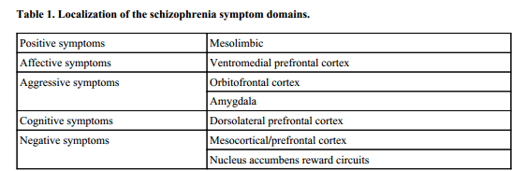
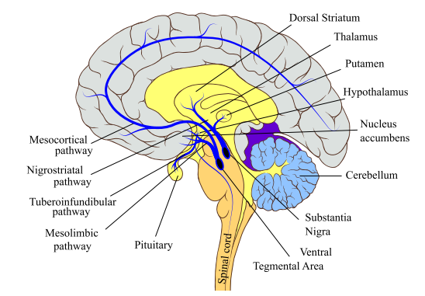
Some dopamine pathways in the mammalian brain:

Slide 7
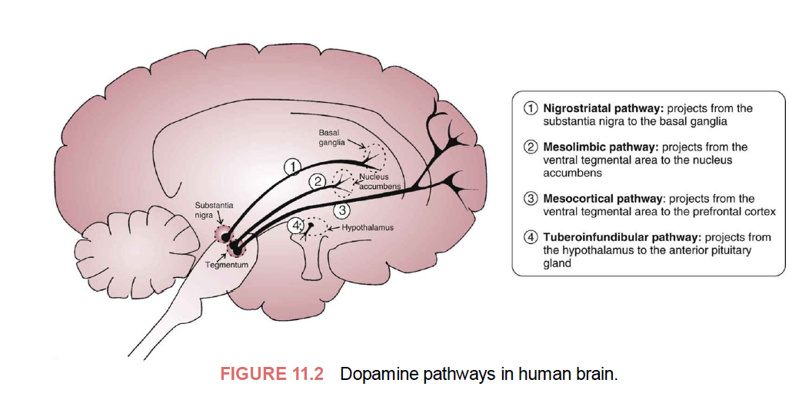
integrating emotions and perceptions, motivated behaviors, and executive functions

Slide 8
The Dopaminergic Neurons, Synthesis, and Degradation of Dopamine
most established hypothesis for schizophrenia: anomaly of biochemical pathways of dopamine (DA)
Amino acid tyrosine:
  precursor at the dopaminergic nerve terminals for the dopamine biosynthesis
  Pumped in via tyrosine transporter
presynaptic transporter (DAT)
  specific for dopamine and terminates the action of dopamine in the synapse
  MAOA or B (within the cells), and COMT, AD, destroy it(synaptic cleft)

Slide 9
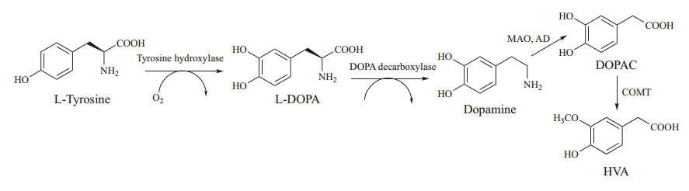
Biosynthesis and degradation of dopamine. L-DOPA, L-dihydroxy methyl alanine; DOPAC, dihydroxy phenyl acetic acid; HVA, homovanillic acid

Slide 10
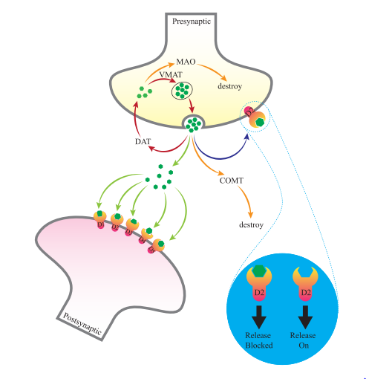
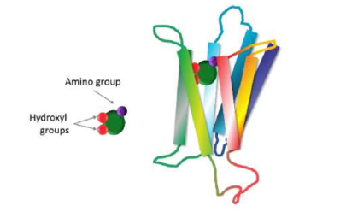
Receptors of Dopamine
The dopamine molecule and its bound state inside the heptahelical D2 receptor
Production, release, binding and destruction of dopamine in synaptic membranes

Slide 11
D1-type(D₁, D₅ receptor, Gs)
D2-type(D_{3,} D₄ receptors, Gi)
D3 found in NA(modulates Glu &DA, targeting it may improve negative symptoms)
EP NS pathway(pars compacta of SN in midbrain, project to BG structures (Caudate N, Putamen)
Key role in locomotor coordination
Degeneration of neurons in NS pathway(PD,bradykinesia, muscular rigidity, resting tremor, impairment of postural balance)

Slide 12
The amino acids essential for proper binding of the ligands to the D2R are broadly classified into three groups
ASP-114 in TM3: carboxylic group of aspartate moiety through a tight salt bridge.
The primary amino group of dopamine interacts with the acid tail of aspartate(conserved over all five subtypes)

Slide 13
Hydrophobic pocket: Three clusters of amino acids
Phe-110, Met-117 and Cys-118 of TM3;
Phe-164, Phe-189 and Val-190 of TM5 and
Trp-386, Phe-390 and His-394 of TM6 shape a hydrophobic pocket for housing dopamine and antipsychotic drugs

Slide 14
Multiple hydrogen bonds with p- and m- hydroxyl groups:
  Ser-193 and Ser-197 of TM5
    form hydrogen bonds with meta and para hydroxyl groups of the dopamine nucleus
    play a crucial role in ligand recognition.
    conserved in all five types of dopamine receptors in humans( along with Ser-194).
  The Ser-194 also forms a hydrogen bond with the ligand

Slide 15
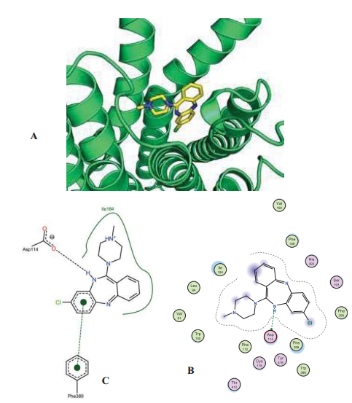
Predicted binding mode of haloperidol at human D2 receptor (hD2R). A) Cartoon representation of clozapine docked to the hD2R at its orthosteric ligand-binding cavity.
Docking performed using GOLD5.3

Slide 16
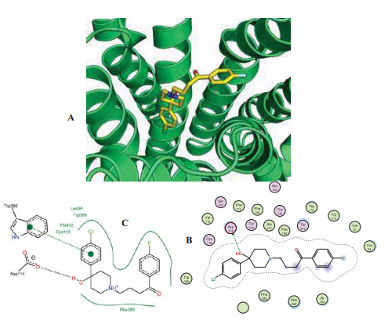
Predicted binding mode of haloperidol at human D2 receptor (hD2R).
A) Cartoon representation of haloperidol docked to the hD2R at its orthosteric ligand-binding cavity.

Slide 17
Additional Neurotransmitters Involvement in
Schizophrenia
Heteroreceptors:
  adenosine (A2), histamine (H1), and serotonin (5-HT1A,2A and 2C), located on or near presynaptic dopaminergic nerve terminals modulate dopamine synthesis (and release)
Adrenergic (α2) autoreceptors:
  negatively modulate the release of the neurotransmitter norepinephrine (atypical antipsychotic drugs)
  interact with other neurotransmitter receptor systems (i.e., histamine, serotonin, and adrenergic)

Slide 18
Serotonin 5-HT2A and 5-HT2C GPCRs have been linked to the pathophysiology and treatment of schizophrenia
activation of 5-HT2A receptors mediates the psychotomimetic effects of some classes of hallucinogenic drugs
activation of 5-HT2C receptors leads to antipsychotic effects
second generation atypical antipsychotic drugs have higher affinity for human serotonin 5-HT2-type receptors than dopamine D2-type receptors

Slide 19
Classes of Antipsychotic Drugs
Depending on
    type of receptor antagonized,
    the incidence of extrapyramidal side effects (EPS),
    efficacy on the treatment-resistant groups and
    freedom from untoward side effects
divided into two classes :
  first-generation antipsychotic drugs: positive symptoms of schizophrenia(extrapyramidal adverse effects)
  second-generation: reduced tendency to cause extrapyramidal

Slide 20
Typical Antipsychotic Drugs
direct interaction with D₂-type receptors
  inverse agonism, antagonism, and partial agonism activity, which of these actions are involved in the clinical outcome is not clear
phenothiazine antipsychotics (e.g., chlorpromazine):
  appreciable affinity at the D1-type, 5-HT2A, 2C,6,7, α1- and α2-type, M1–5, and H1
  accounting for both efficacy and numerous side effects

Slide 21
butyrophenone-type antipsychotics:
  high affinity at α1-type
  moderate affinity at D₁-type and 5-HT₂A
  but not 5-HT₂C GPCRs in addition to their action on D₂-type receptors

Slide 22
SAR of Chlorpromazine and Thiothixene Antipsychotics
Binding occur through a similar conformation like DA (trans α-rotamer conformation)

Slide 23
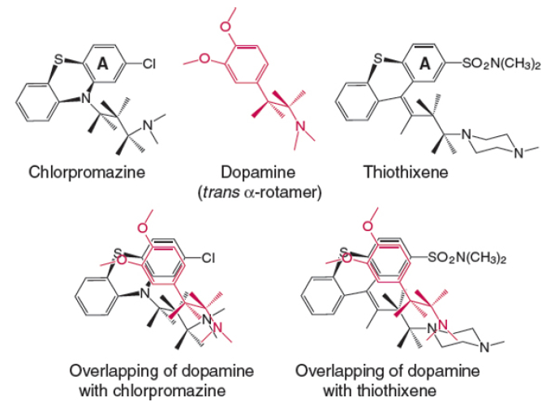
Representation of dopamine in a trans α-rotamer conformation and how it might be superimposed with specific conformations of chlorpromazine and thiothixene

Slide 24
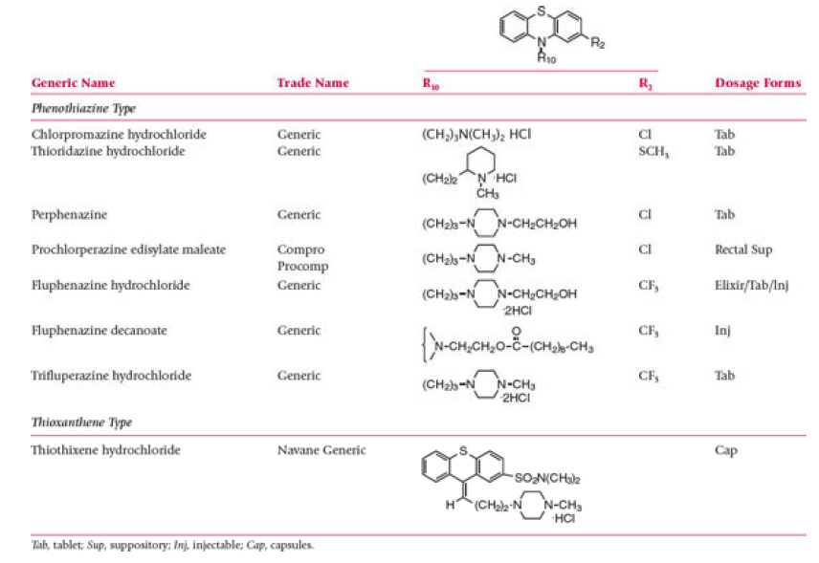

Slide 25
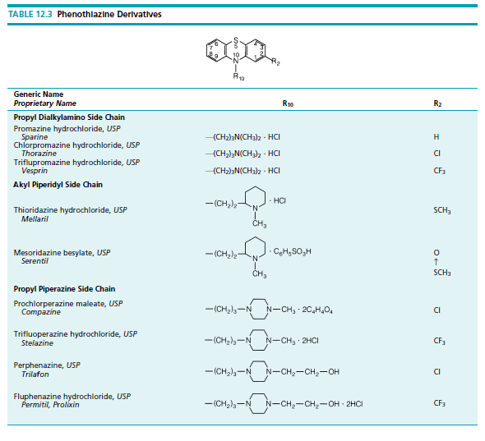

Slide 26
The electronegative atom at C2 (e.g., Cl, CF3, SCH3) on ring “A” is essential for activity
three unbranched methylene groups separating the two nitrogen atoms is required
Replacement of N10-C11 unit with a carbon-carbon double bond
  cis isomer: several-fold greater activity than the trans isomer

Slide 27
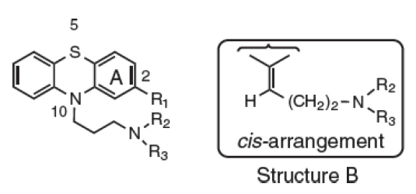

Slide 28
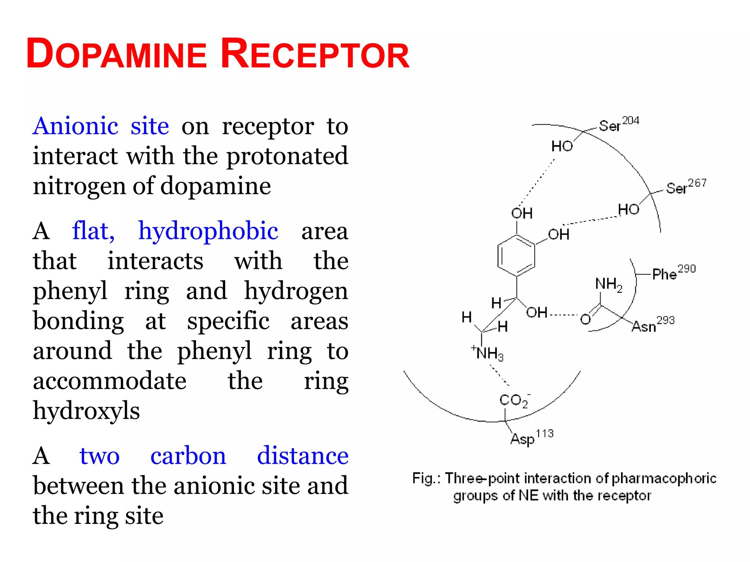

Slide 29
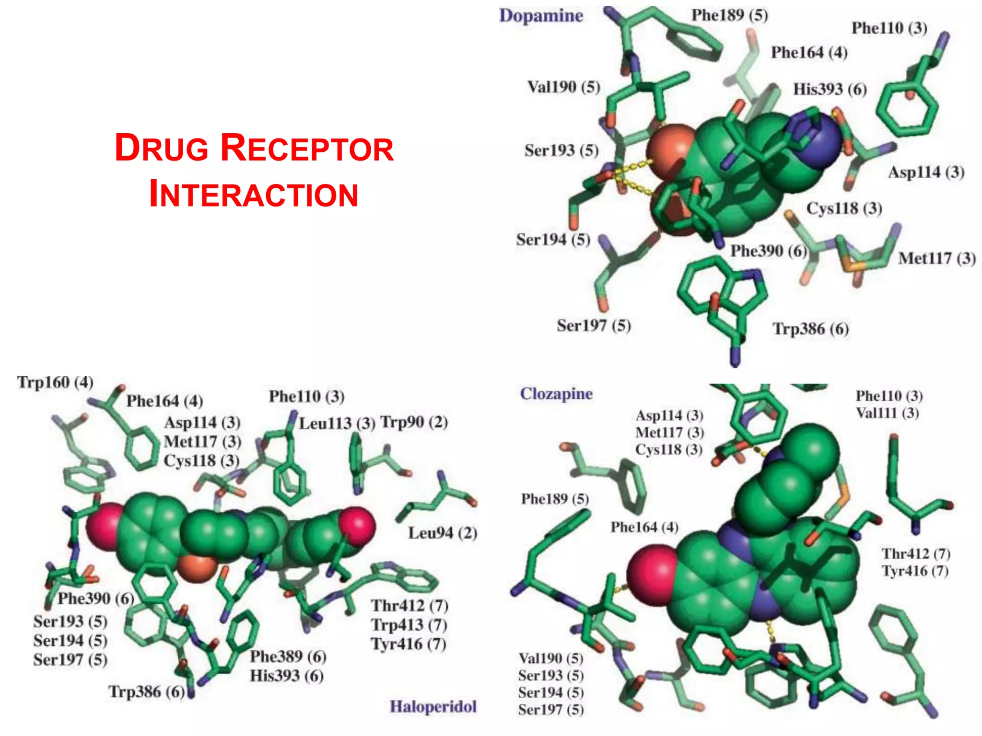

Slide 30
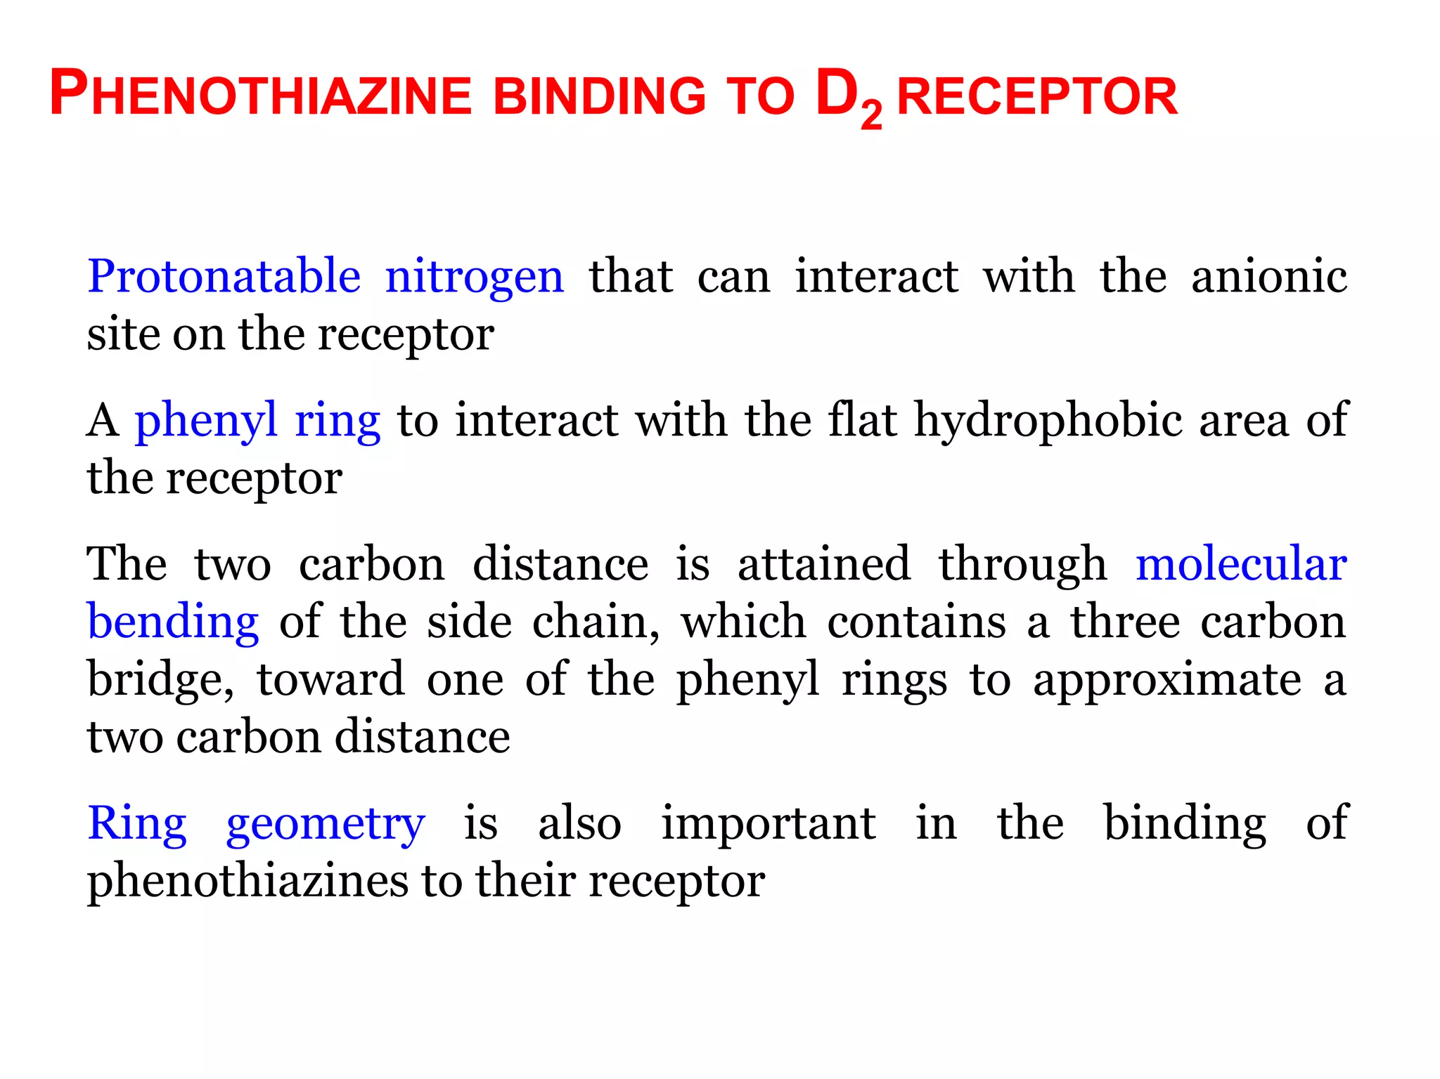

Slide 31
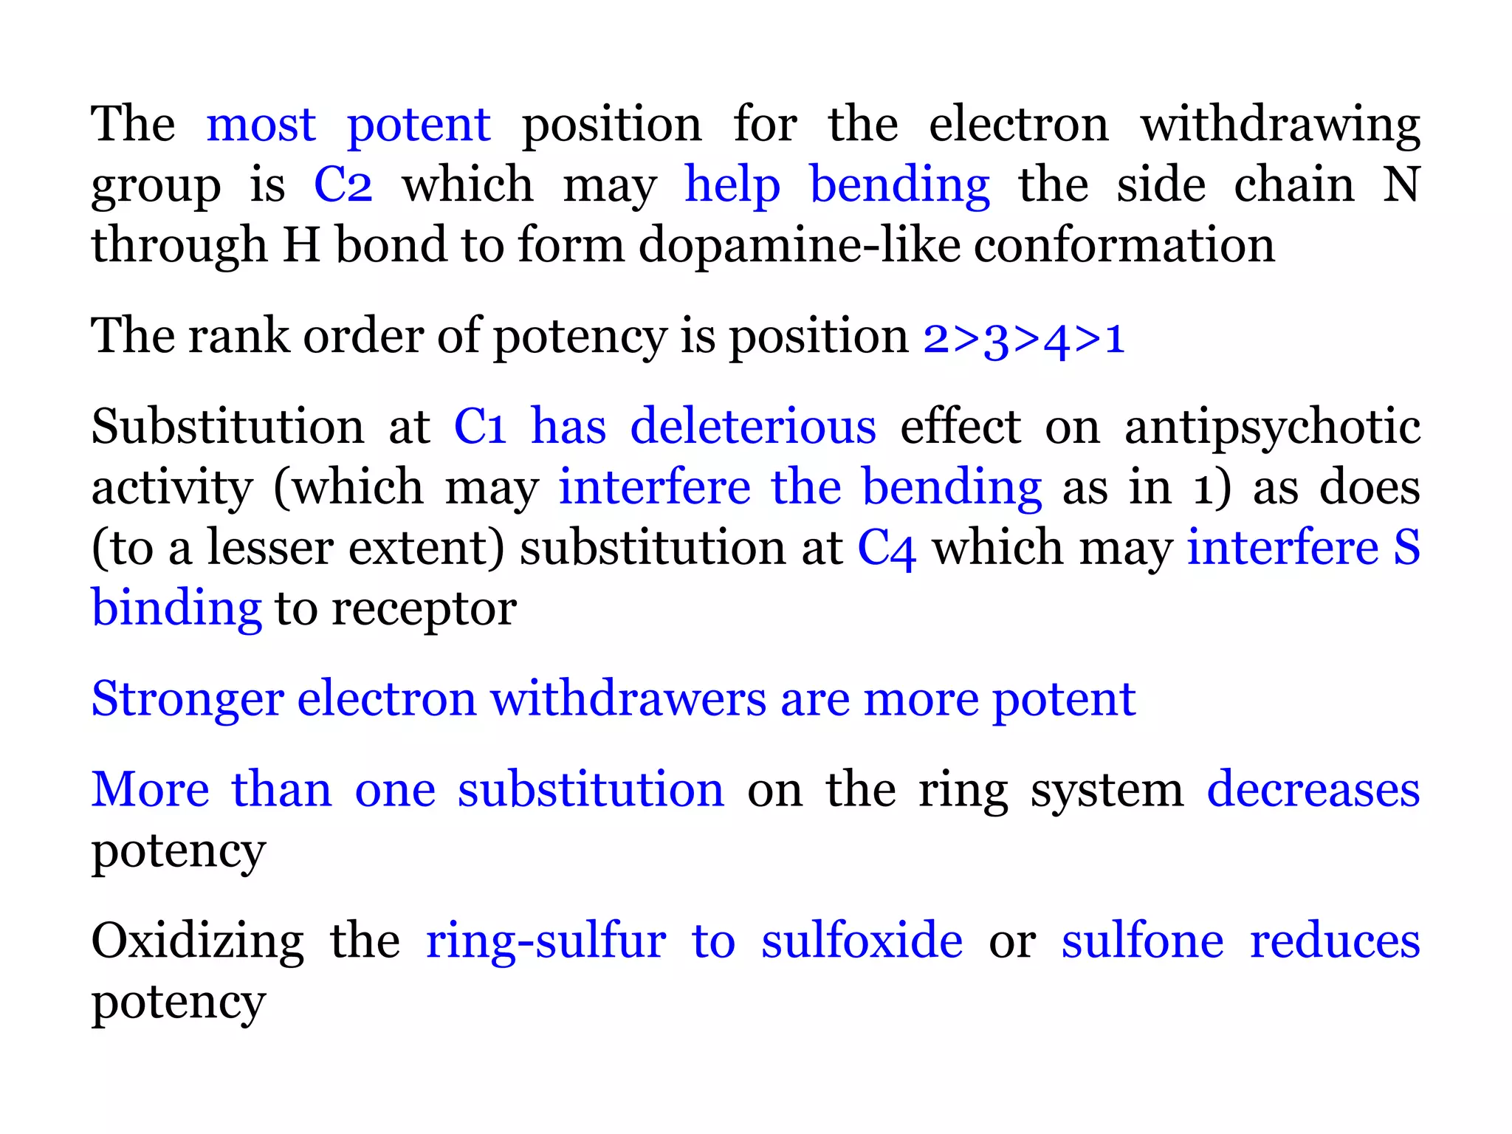

Slide 32
Based on the mechanism of action
grouped into three different categories:
typical antipsychotics: high D2 antagonism and low 5-HT2A antagonism;
atypical antipsychotics: moderate to high D2 antagonism and high 5-HT2A antagonism; and
atypical clozapine-like antipsychotics: low D2 antagonism and high 5-HT2A antagonism

Slide 33
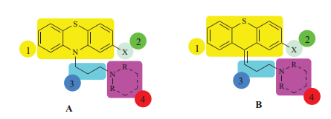
FG (Typical) Antipsychotic Drugs
Include: chlorpromazine, haloperidol, fluphenazine, flupenthixol, clopenthixol
SAR of the Phenothiazine Ring :
  depends on four aspects as shown in the color-mapped pharmacophoric illustration
Structures of phenothiazine (A) and related thioxanthene (B) antipsychotics pharmacophores
Phenothiazene/thioxanthene nucleus
ring substituent
3-carbon side chain
side chain N-substituents(protonated amine moiety)

Slide 34
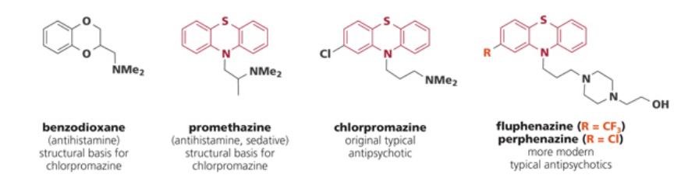
1952 to potentiate the effects of anesthesia (sedating effect)
to control psychosis (anti-serotonin effects, weak, 1955)
antidopamine effects-antipsychotic by Carlsson 1960
  Nobel Prize in Physiology or Medicine 2000
  led to searches for dopamine antagonists as new anti-schizophrenic agents

Slide 35
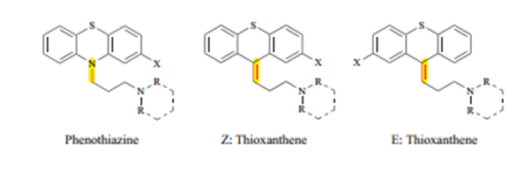
The phenothiazine nucleus with N at 10 or
double bond at C-10 possesses the optimal structural conformation to bind the dopamine receptors.
  requires a Z -(cis) conformation for optimal receptor-ligand interaction

Slide 36
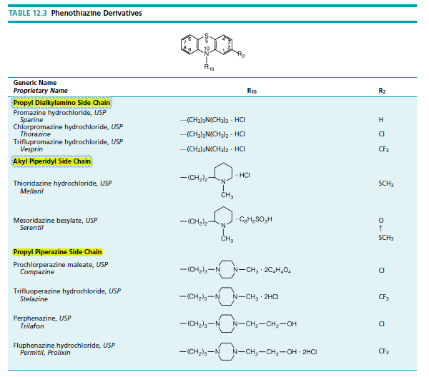

Slide 37
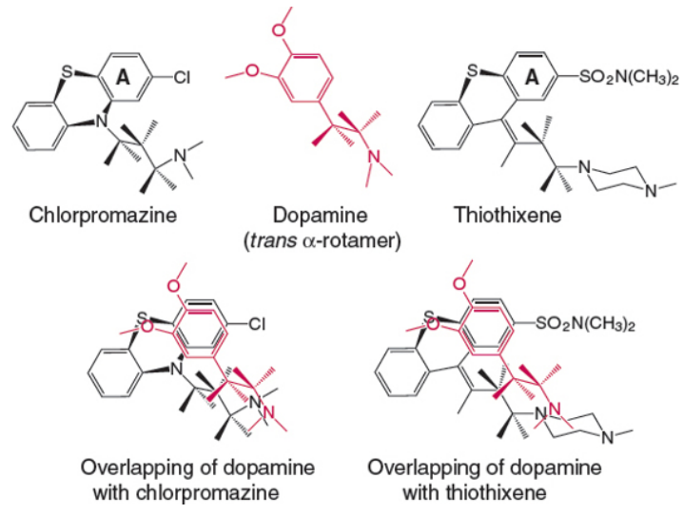
Representation of dopamine in a trans α-rotamer conformation and how it might be superimposed with specific conformations of chlorpromazine and thiothixene based upon X-ray crystallographic analysis.

Slide 38
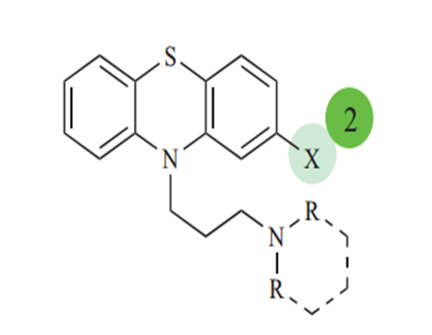
The substituent at position 2
electron-withdrawing moiety(optimum affinity)
enhance activity through two effects:
Pulls the electrons away from ring “A” resulting in a δ+ charge on the ring increasing binding of the ring to an electron-rich area on the receptor (induced dipole-induced dipole interaction)
Pulls the protonated nitrogen toward the phenyl ring providing the proper spacing between the nitrogen and the ring (two-carbon distance)

Slide 39
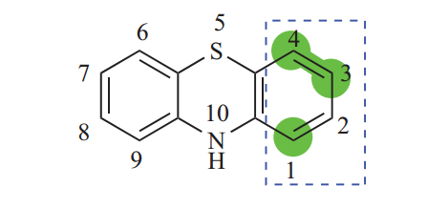
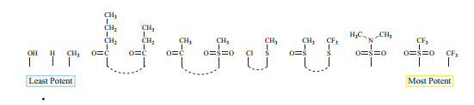
Substitution at positions 1, 3, and 4 diminishes or decreases the activity
The rank order of potency is position 2>3>4>1
Commonly occurring various groups at position 2 are as follows

Slide 40
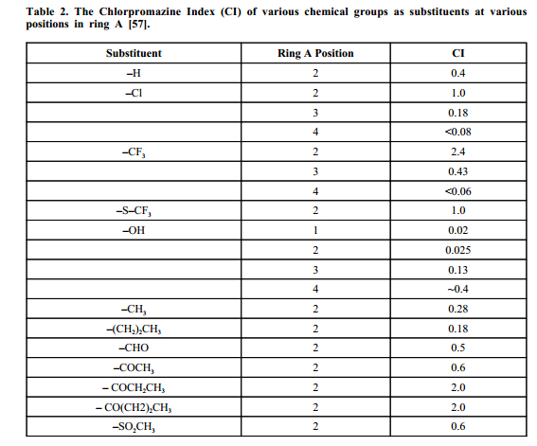
CI is the ratio of the potency of the compound to that of chlorpromazine
CI values higher than 1 indicates a compound more potent than chlorpromazine

Slide 41
  Likewise, the substitution at C4 may interfere with substrate binding to the receptor as the p-OH of the dopamine molecule does.
  stronger electron withdrawers are usually more potent.
  More than one substitution on the ring system decreases the potency
  Oxidizing the ring-sulfur to sulfoxide or sulfone reduces the potency

Slide 42
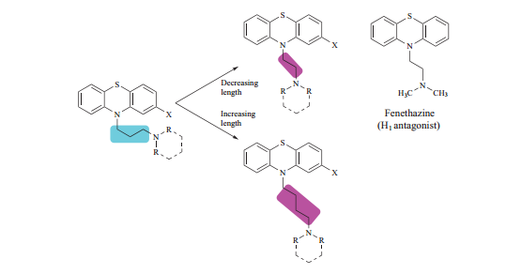
Increasing or decreasing the length from 3 carbons decreases the potency.
Two carbon side chains increase H1 antagonism (Fenethazine)
β-methyl group
increases or decreases Antipsychotic activity
increases H1 antagonism
Larger than Me decrease antihistaminic activity unless part of heterocyclic
antiDA decreases, anticholinergic effect is increased (γ substitution, all piperidines)
α, β- or γ-carbon substitutions alters the potency and induces side effects

Slide 43
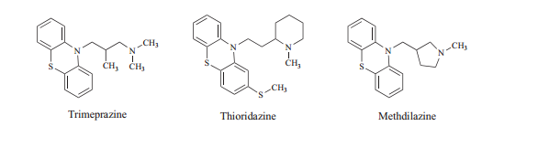
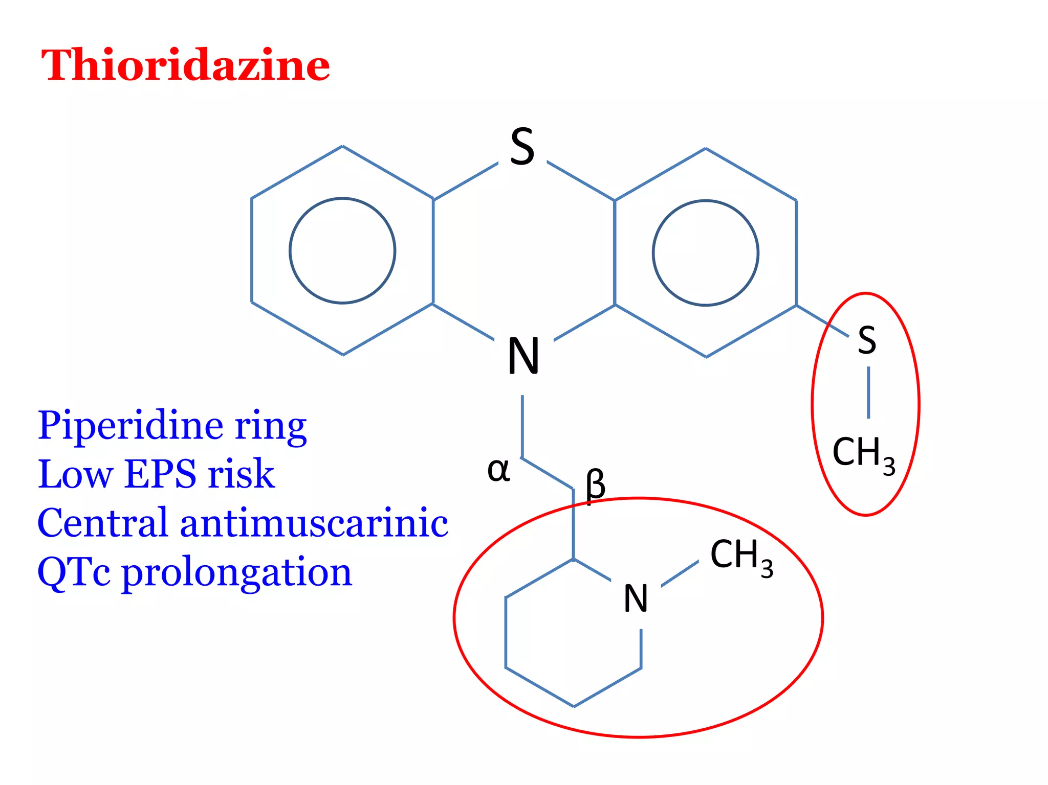

Slide 44
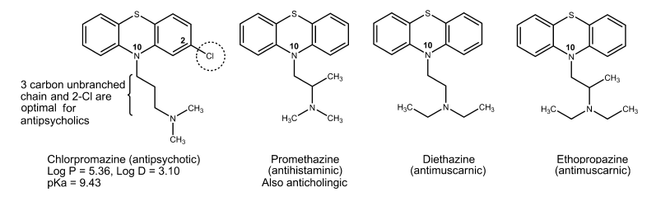

Slide 45
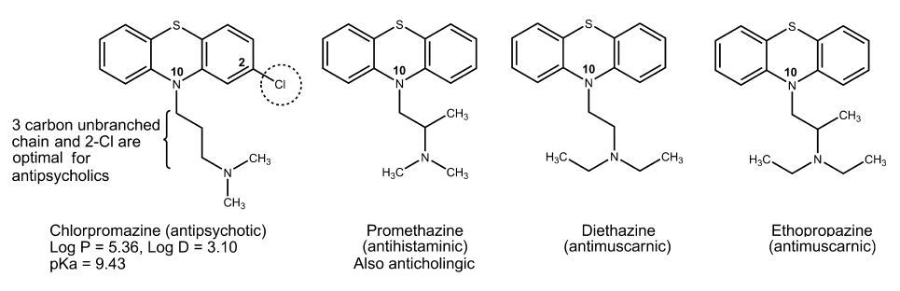

Slide 46
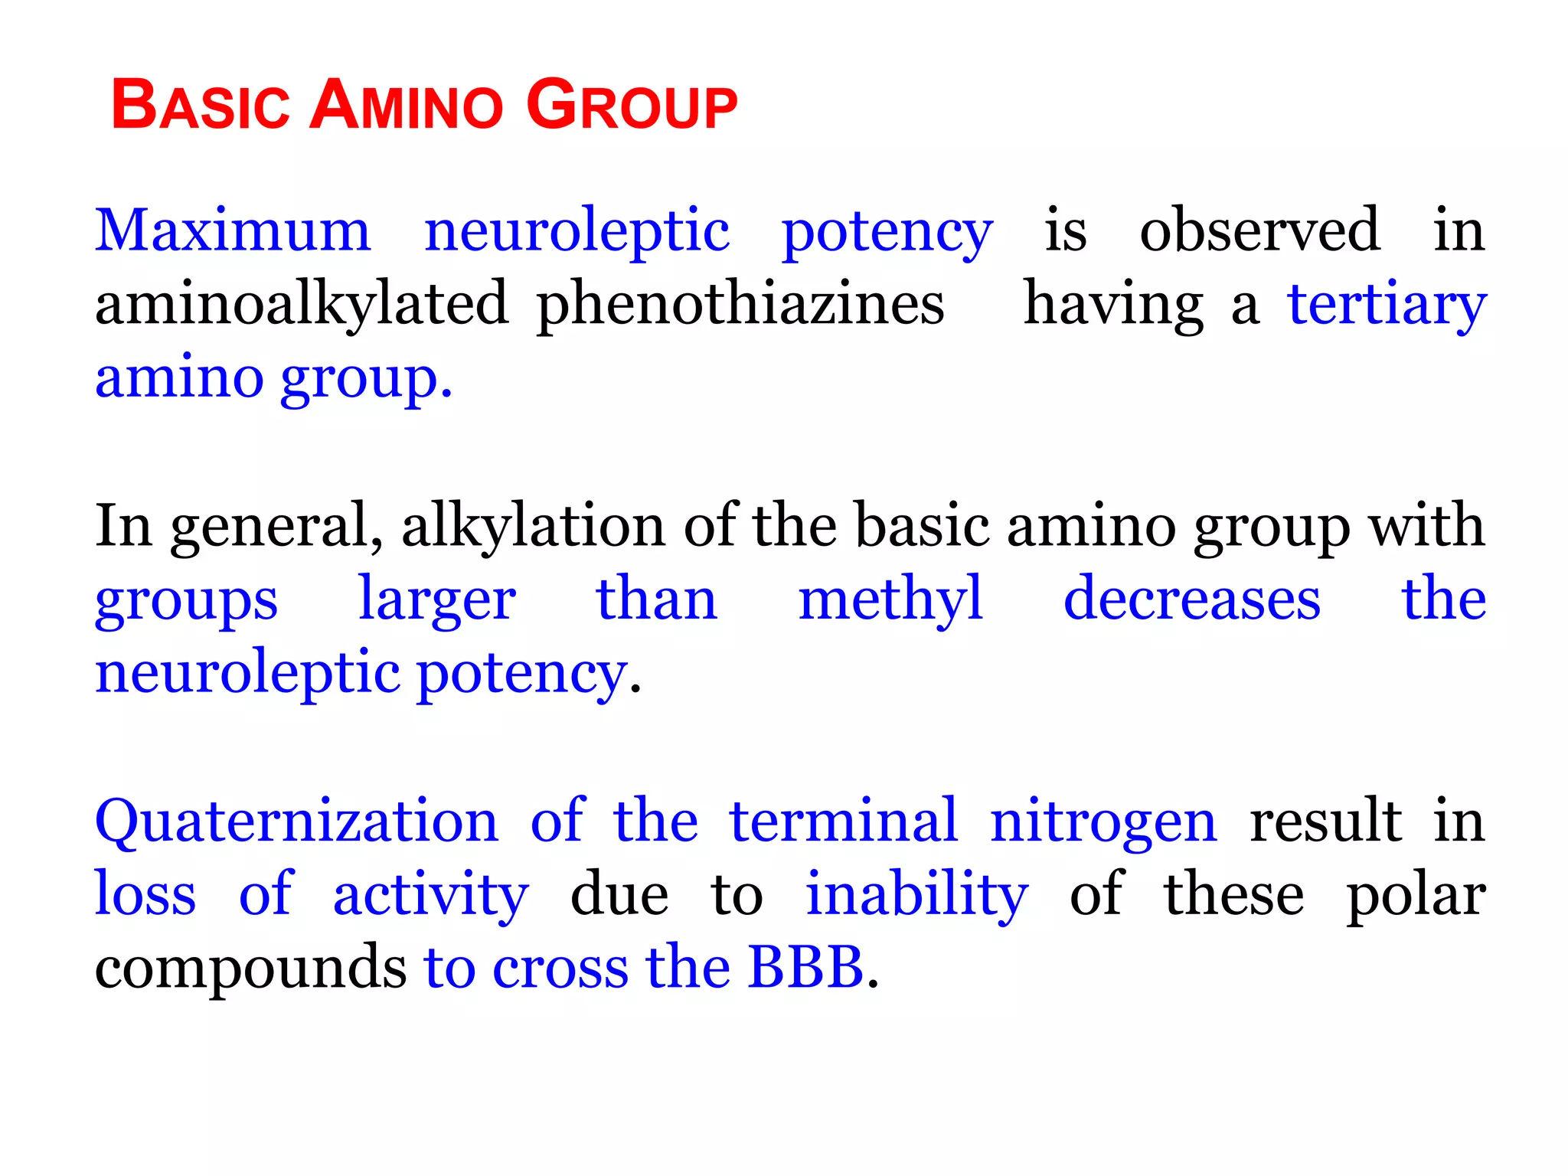

Slide 47
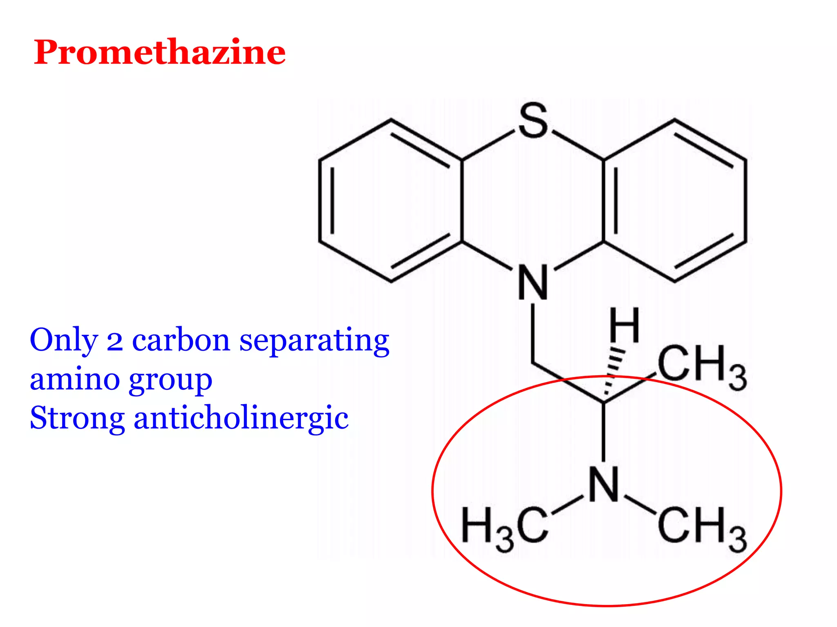

Slide 48
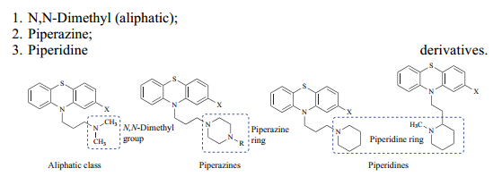
The optimal affinity for the dopamine receptors relies on the terminal amine moiety.
The substitution on γ-nitrogen may lead to three classes of phenothiazines:

Slide 49
Aliphatic class
Two methyl groups may substitute the hydrogens at the γ-nitrogen to produce an N,N-dimethyl derivative.
The compounds usually have –promazine at the suffix, and the C-2 substitution determines the prefix
  primary amines: low potency
  Monomethyl compounds: better but still very weak
  dimethyl substitution: highest potency

Slide 50
Potency is decreased if the carbon length of the substituted group is increased
However, if the increased carbon-length forms a heterocyclic shape, then the potency is increased
The γ- N substitution renders potency based on the following order:
  piperazine > aliphatic > piperidine

Slide 51
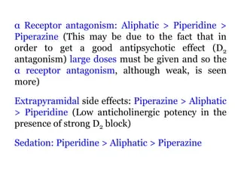

Slide 52
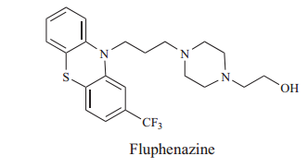
Piperazine class of antipsychotics
the γ- nitrogen becomes a part of the piperazine ring
Para N-methyl, the suffix becomes ‘-perazine’
para N-hydroxyethyl group attached the suffix becomes ‘-phenazine’
The prefix of the name depends on the C2 substituent.
  E.g. Fluphenazine has a trifluoromethyl substituent at the C2 position of the phenothiazine ring
  P-N enhances receptor binding (piperazine is better than piperidine)
  Substitution at the ring increases potency(N-Eth-OH(more potent),N-Me more potent than N-H₂ )
  Piperazine bearing phenothiazines possess the highest degree of D2 antagonism

Slide 53
Piperidine antipsychotics
γ- nitrogen incorporated into a piperidine ring
The phenothiazines using this derivative are 2-piperidines
A 1-piperidine behaves more like piperazine.
  Their names commonly end with the “–ridazine” and the nature of C2 substituent determines the prefix of the name
  For example, thioridazine has a thiomethyl group at the C2 position

Slide 54
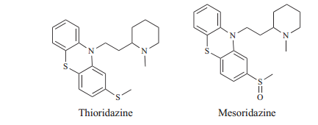
branching on γ-carbon adversely affects D2 affinity
lowest potency of the three classes of phenothiazines
exert the most potent anticholinergic effect
Thioridazine is a thioether, oxidation of the sulfur gives mesoridazine that retains activity

Slide 55
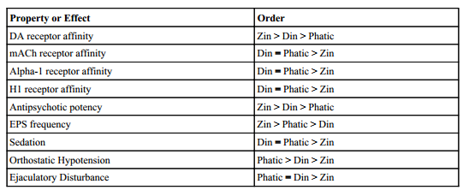
Potency at the D2 Receptors
The abbreviated “Zin(piperazine)”, “Din(piperadine)”, and “Phatic” forms are used for the sake of simplicity
If the C2 substitution remains unchanged, then the order of potency is: Piperazine > Aliphatic > Piperidine

Slide 56
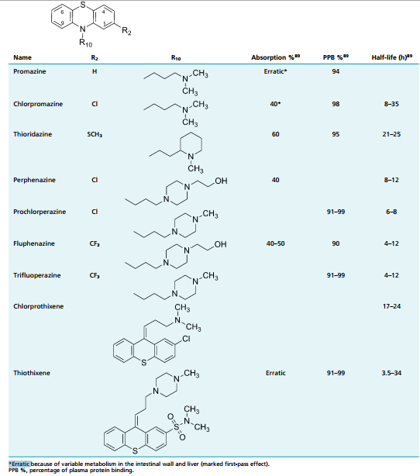

Slide 57
Chlorpromazine Hydrochloride
2-chloro-10-[3-(dimethylamino)propyl]phenothiazine (Thorazine)
crystalline powder (pKa = 9.43)
has significant sedative and hypotensive properties
  central and peripheral α1-adrenergic blocking activity
  strong anticholinergic and sedative effects and is a potent antiemetic
major substrate of CYP2D6 (minor:CYP1A2 and 3A4)
(concentration in blood is lower after several weeks of treatment at the same dosage, Weak inducer of CYP ₂D_{6,} decreased, GIT motility)

Slide 58
availability of 25% to 35% because of significant first-pass metabolism
low-potency neuroleptic agent
Sedative(anti-H), anticholinergic, and cardiovascular(alpha blocker) side effects is high
indicated for the symptomatic relief of nausea, vomiting, hiccups, and porphyria; for preoperative sedation; and for the treatment of psychotic disorders.

Slide 59
Metabolism of Chlorpromazine and Thiothixene Antipsychotics
N-Dealkylation involving demethylation is quite common
Aromatic oxidation at position C7
S-Oxidation to an inactive metabolite
Ester hydrolysis of the long-acting fluphenazine gives rise to the active fluphenazine

Slide 60
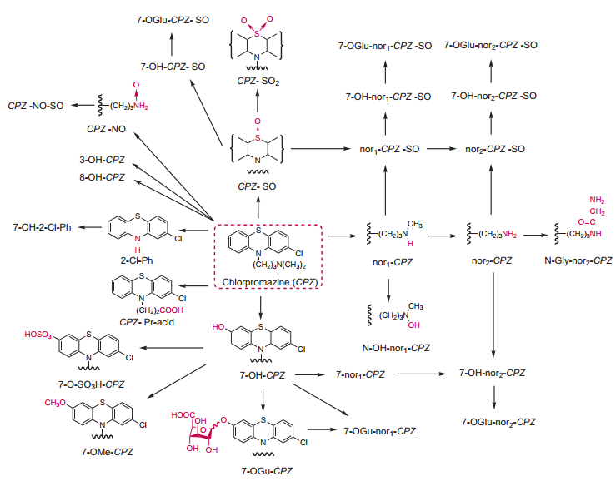

Slide 61
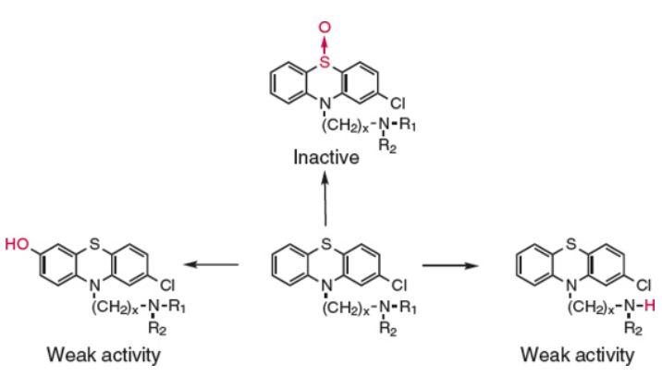
Common metabolic pathways for phenothiazine type antipsychotic agents. N-dealkylations and 7-hydroxylation are the most common oxidative reactions catalyzed by CYP2D6 while S-oxidation metabolites have also been identified

Slide 62
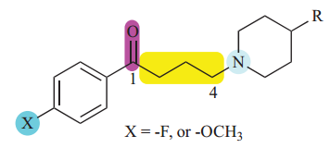
Butyrophenone Antipsychotics and Related SAR
Butyrophenone Pharmacophore and SAR
Butyrophenone (but- for four carbons, phen- for benzene and -one for the presence of a ketone group)
potent group of neuroleptics possessing a general structure and the pharmacophore as shown
General structure of butyrophenone derivatives showing the pharmacophore

Slide 63
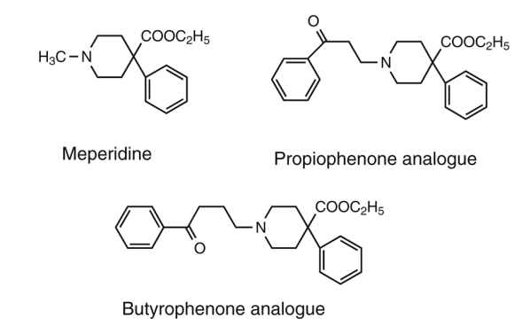

Slide 64
tertiary amine for optimum neuroleptic function
  highest activity when it is incorporated into a cyclic form
three-carbon long: b/n nitrogen and carbonyl carbon; shortening or elongating decreases the potency
  lengthening, shortening, or branching of the three carbon propyl chain decreases neuroleptic potency
Alteration of the keto moiety decreases potency.
  Replacing with thioketone (as in butyrothienones)
  Replacing with olefinic or phenoxy groups
  Reduction of the carbonyl functional group
  fluorine substitution(P-benzene): Most potent(e.g haloperidol)

Slide 65
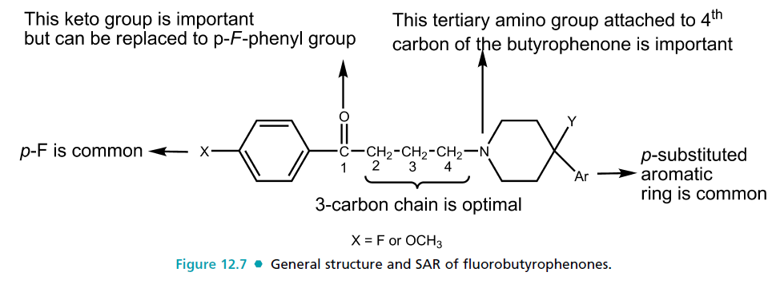

Slide 66
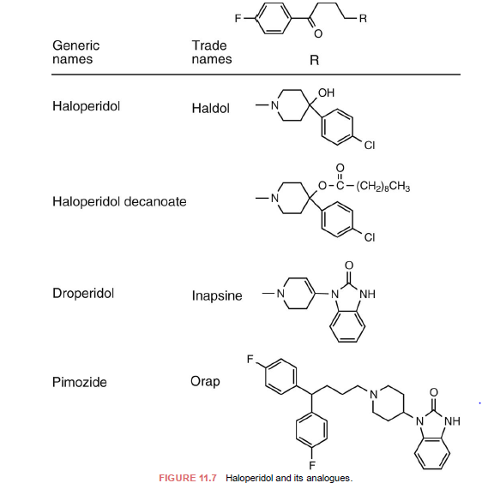

Slide 67
Potency may be retained if a variation is introduced into the tertiary amino group. For instance, the nitrogen may be a part of a six-membered ring
  (e.g., piperidine, tetrahydropyridine, or piperazine) in which a substitution is made at the para position.
The haloperidol butyrophenone side chain may be modified by replacing the keto group with a di-4flurophenylmethane, which results in diphenylbutyl piperidine neuroleptics (e.g., pimozide) possessing a longer duration of action.

Slide 68
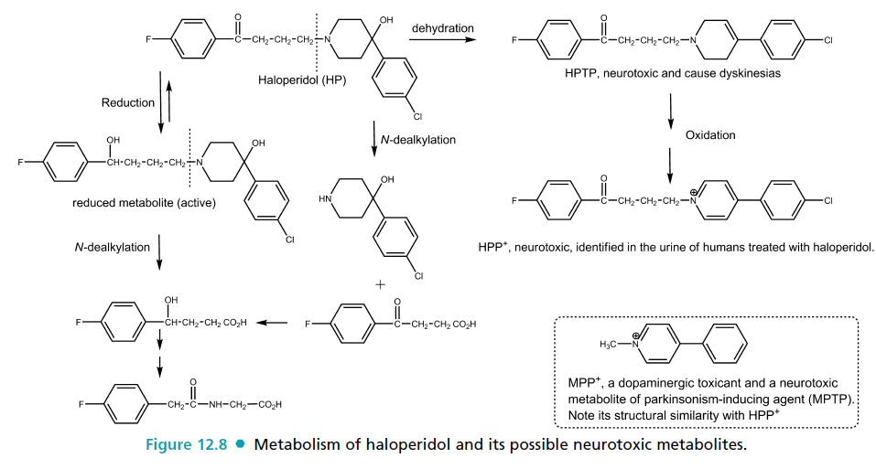
1-methyl-4-phenyl-1,2,3,6-tetrahydropyridine (MPTP)

Slide 69
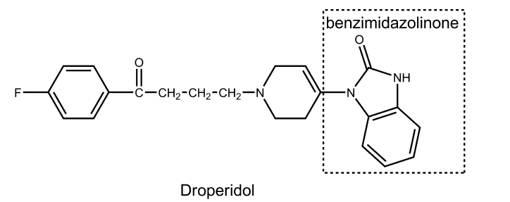
may be used alone as a preanesthetic neuroleptic or as an antiemetic
its most frequent use is in combination with the narcotic agent fentanyl preanesthetically (very shortacting and highly sedating properties)

Slide 70
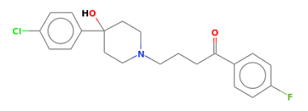
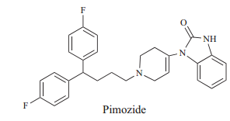
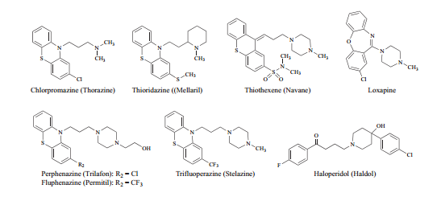
Haloperidol
Structures of selected first-generation antipsychotic agents

Slide 71
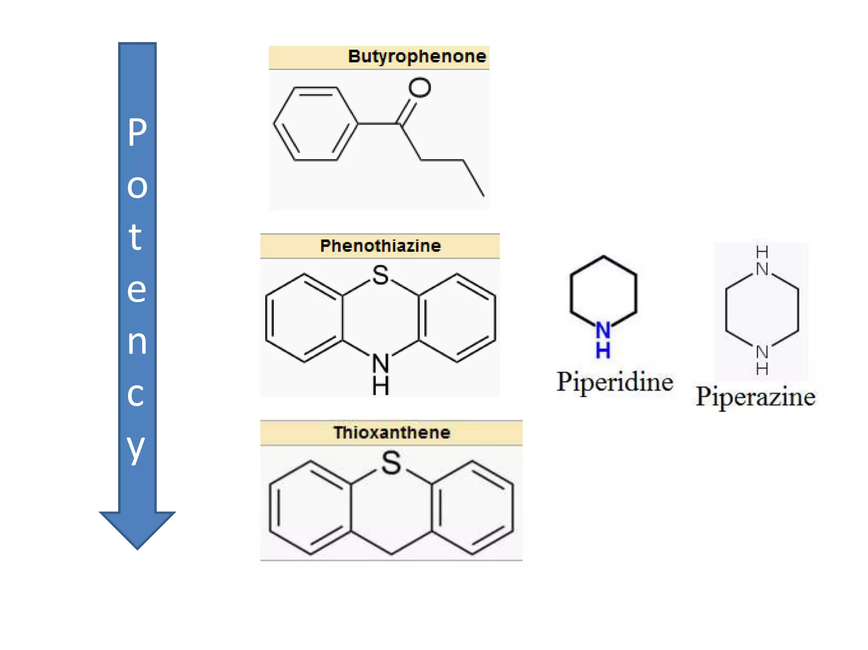

Slide 72
4-aryl piperidino moiety is superimposable on the 2-phenylethylamino moiety of DA and, accordingly, could promote affinity for D2 and D3 receptors
The long N-alkyl substituent could help promote receptor affinity and produce receptor antagonism activity and/or inverse agonism

Slide 73




Slide 74
SECOND GENERATION (ATYPICAL) ANTIPSYCHOTICS
have an affinity to both dopamine D2-type and other receptors serotonin 5-HT2A GPCRs at varying degrees
higher affinity for the serotonin receptor(fewer EPS effects)
“negative” symptoms of the first-generation antipsychotic is believed to be associated with interaction with a range of non-dopamine receptors
differ in their mechanisms of action and in the manner in which they produce an atypical therapeutic profile

Slide 75

antipsychotic-associated weight gain and general metabolic dysregulation leading to cardiovascular and diabetic disorders
antipsychotic-associated weight gain and general metabolic dysregulation leading to cardiovascular and diabetic disorders
believed to be linked to the serotonin 5HT2C and/or antagonism or inverse agonism of the histamine H1receptors

Slide 76

primarily two chemical classes of atypical antipsychotic agents:
  the diarylazepines and the benzisoxazole and benzisothiazoles
Thienobenzodiazepine

Slide 77


Slide 78




Slide 79


Benzisoxazole and Benzisothiazole

Slide 80


Slide 81



Slide 82

Phenylpiperazines

Slide 83
Ring Analogs of Phenothiazines: Benzazepines, Dibenzoxazepines, and Dibenzodiazepines
seven-membered central ring (6-7-6 system): include
  dibenzodiazepines (clozapine with 2-Cl)
  dibenzoxazepines (loxapine with 2-Cl)
  thienobenzodiazepines (olanzapine without 2-substituent)
  dibenzothiazepines (quetiapine without 2-substituent)
structural relatives of the phenothiazine antipsychotics
most of them share many clinical properties with the phenothiazines

Slide 84
important differences, notably low production of EPS and reduction of negative symptoms
block both D2 and 5-HT2A receptor, other DA and serotonin receptor subtypes, adrenergic, histamine, and muscarinic receptors
  risperidone, ziprasidone, and aripiprazole
low D2 receptor affinity and the high 5-HT2A receptor affinity
  including clozapine and olanzapine led to the proposal that 5-HT2A antagonism accounts for their lower EPS

Slide 85



More potent antagonist at D2 and 5-HT2A receptors
Tmax(6hrs), t_{1/2}(20-54hrs)
Metabolism: CYP1A2(major), with CYP2D6
Decreased striatal D2-blocking activity (EPS)
Metabolize:
CYP3A4 to inactive
readily excreted sulfoxide and acidic derivatives
Clozapine analogs

Slide 86

Its superior side effects profile (compared with haloperidol) at dosage of 6 mg/d
less and the lower risk of tardive dyskinesia have contributed to its very widespread use.
It benefited refractory psychotic patients, with parkinsonism controlled at one tenth the dose of antiparkinsonian drugs used with haloperidol.

Slide 87
Coexisting anxiety and depressive syndromes were also lessened
decrease the negative (e.g., withdrawal, apathy)1
the positive (e.g., delusions, hallucinations) symptoms of schizophrenia (antiD2R-5_HT2A combination effect), high affinity at H1, a1,2
less or extrapyramidal side effects(no dopamine inhibitory effect in the striatum and cortex, activate 5-HT1A in the brain and partial D2 agonist activity in some selective cells)

Slide 88

2-5mg/day-blocks 60-79% D2R
>6mg/day-blocks more than 77% D2R-devt of EPS
Similar pharmacological and toxicological profiles
Blocks D2R, 5HT2A receptors, α1, α2, and H1 receptors
Oral BA 28%

Slide 89

well absorbed orally(60% BA)
2/3th metabolized by aldehyde oxidase (reductive cleavage of benzisothiazole ring)
1/3 rd metabolized by CYP3A4 (oxidation)

Slide 90

arylpiperazine quinoline derivative
D2) and serotonin (5-HT1A & 5-HT2A/C) receptor inhibitions
high affinity partial agonist effect to some D2 receptors depending on cell type(low EPS)
Low anti-cholinergic, sedation, wt gain, orthostatic hypotension
High oral BA (~90%), extensive metabolism by CYP2D6 and CYP3A4 through dehydrogenation, hydroxylation, N-dealkylation

Slide 91
Brexpiprazole
successor of aripiprazole containing the same
  quinoline ring system of its active metabolite dehydroaripiprazole,
  thiophene ring system replaced the dichlorobenzene ring
developed by the same pharmaceuticals to provide improved efficacy and tolerability
  partial agonist at D2, D3, and 5-HT1A receptors
  considered as a modulator of serotonin-dopamine activity
It has lower dopamine receptor affinity, but higher serotonin receptor affinity than aripiprazole

Slide 92
bioavailability of 95% and a long half-life (~90 hrs)
extensively metabolized by CYP2D6 and CYP3A4 via sulfoxidation forming the major metabolite DM-3411 (brexpiprazole sulfoxide)

